Slide 1

Dynamic Programming
Design and Analysis of
Algorithms
Rajesh Kumar Tripathi
Assistant Professor, Dept. CEA

Slide 2
Dynamic Programming
A dynamic-programming algorithm solves each subsubproblem just once and then saves its answer in a table, thereby avoiding the work of recomputing the answer every time it solves each subsubproblem
Dynamic programming is applied when the sub-problems overlaps-
-- when sub-problems share sub-subproblems.
-- apply it to optimization problems

Slide 3
Dynamic Programming
Dynamic programming is used for optimization problems:
-- 0/1 Knapsack
-- Longest common sub-sequence
-- Matrix chain multiplication
-- Resource allocation problems
-- All pair shortest paths

Slide 4
Dynamic Programming
Dynamic programming steps:
-- Characterize the structure of an optimal solution
-- Recursively define the value of an optimal solution
-- Compute the value of an optimal solution, typically in a bottom-up fashion.
-- Construct an optimal solution from computed information.

Slide 5
0/1 Knapsack Problem
Knapsack(p,wt,m,n)
for i=1 to n
for w=0 to m
if i==0 || w==0
k[i][w]=0
else if wt[i]<=w
k[i][w]=max(p[i]+k[i-1][w-wt[i]], k[i-1][w])
else
k[i][w]=k[i-1][w]

Slide 6
0/1 Knapsack Problem
Knapsack(p,wt,m,n)
for i=1 to n
for w=0 to m
if i==0 || w==0
k[i][w]=0
else if wt[i]<=w
k[i][w]=max(p[i]+k[i-1][w-wt[i]], k[i-1][w])
else
k[i][w]=k[i-1][w]
n=4
Pi
1 | 2 | 5 | 6
m=8
Wi
2 | 3 | 4 | 5
0 | 1 | 2 | 3 | 4 | 5 | 6 | 7 | 8
0 | 0 | 0 | 0 | 0 | 0 | 0 | 0 | 0
P_{i}
1
2
5
6
w_{i}
2
3
4
5
0
1
2
3
4

Slide 7
0/1 Knapsack Problem
Knapsack(p,wt,m,n)
for i=1 to n
for w=0 to m
if i==0 || w==0
k[i][w]=0
else if wt[i]<=w
k[i][w]=max(p[i]+k[i-1][w-wt[i]], k[i-1][w])
else
k[i][w]=k[i-1][w]
n=4
Pi
1 | 2 | 5 | 6
m=8
Wi
2 | 3 | 4 | 5
0 | 1 | 2 | 3 | 4 | 5 | 6 | 7 | 8
0 | 0 | 0 | 0 | 0 | 0 | 0 | 0 | 0
0
0
0
0
P_{i}
1
2
5
6
w_{i}
2
3
4
5
0
1
2
3
4

Slide 8
0/1 Knapsack Problem
Knapsack(p,wt,m,n)
for i=1 to n
for w=0 to m
if i==0 || w==0
k[i][w]=0
else if wt[i]<=w
k[i][w]=max(p[i]+k[i-1][w-wt[i]], k[i-1][w])
else
k[i][w]=k[i-1][w]
n=4
Pi
1 | 2 | 5 | 6
m=8
Wi
2 | 3 | 4 | 5
0 | 1 | 2 | 3 | 4 | 5 | 6 | 7 | 8
0 | 0 | 0 | 0 | 0 | 0 | 0 | 0 | 0
0 | 0 | 1 | 1 | 1 | 1 | 1 | 1 | 1
0
0
0
P_{i}
1
2
5
6
w_{i}
2
3
4
5
0
1
2
3
4

Slide 9
0/1 Knapsack Problem
Knapsack(p,wt,m,n)
for i=1 to n
for w=0 to m
if i==0 || w==0
k[i][w]=0
else if wt[i]<=w
k[i][w]=max(p[i]+k[i-1][w-wt[i]], k[i-1][w])
else
k[i][w]=k[i-1][w]
n=4
Pi
1 | 2 | 5 | 6
m=8
Wi
2 | 3 | 4 | 5
0 | 1 | 2 | 3 | 4 | 5 | 6 | 7 | 8
0 | 0 | 0 | 0 | 0 | 0 | 0 | 0 | 0
0 | 0 | 1 | 1 | 1 | 1 | 1 | 1 | 1
0 | 0 | 1 | 2 | 2 | 3 | 3 | 3 | 3
0
0
P_{i}
1
2
5
6
w_{i}
2
3
4
5
0
1
2
3
4

Slide 10
0/1 Knapsack Problem
Knapsack(p,wt,m,n)
for i=1 to n
for w=0 to m
if i==0 || w==0
k[i][w]=0
else if wt[i]<=w
k[i][w]=max(p[i]+k[i-1][w-wt[i]], k[i-1][w])
else
k[i][w]=k[i-1][w]
n=4
Pi
1 | 2 | 5 | 6
m=8
Wi
2 | 3 | 4 | 5
0 | 1 | 2 | 3 | 4 | 5 | 6 | 7 | 8
0 | 0 | 0 | 0 | 0 | 0 | 0 | 0 | 0
0 | 0 | 1 | 1 | 1 | 1 | 1 | 1 | 1
0 | 0 | 1 | 2 | 2 | 3 | 3 | 3 | 3
0 | 0 | 1 | 2 | 5 | 5 | 6 | 7 | 7
0
P_{i}
1
2
5
6
w_{i}
2
3
4
5
0
1
2
3
4

Slide 11
0/1 Knapsack Problem
Knapsack(p,wt,m,n)
for i=1 to n
for w=0 to m
if i==0 || w==0
k[i][w]=0
else if wt[i]<=w
k[i][w]=max(p[i]+k[i-1][w-wt[i]], k[i-1][w])
else
k[i][w]=k[i-1][w]
n=4
Pi
1 | 2 | 5 | 6
m=8
Wi
2 | 3 | 4 | 5
0 | 1 | 2 | 3 | 4 | 5 | 6 | 7 | 8
0 | 0 | 0 | 0 | 0 | 0 | 0 | 0 | 0
0 | 0 | 1 | 1 | 1 | 1 | 1 | 1 | 1
0 | 0 | 1 | 2 | 2 | 3 | 3 | 3 | 3
0 | 0 | 1 | 2 | 5 | 5 | 6 | 7 | 7
0 | 0 | 1 | 2 | 5 | 6 | 6 | 7 | 8
P_{i}
1
2
5
6
w_{i}
2
3
4
5
0
1
2
3
4

Slide 12
Thank You

Slide 13
Dynamic Programming
Design and Analysis of
Algorithms
Rajesh Kumar Tripathi
Assistant Professor, Dept. CEA

Slide 14
Longest Common Subsequence
In the longest-common-subsequence problem, we are given two sequences
X ={x₁; x₂; : : : ; x_{m}} and Y = {y₁; y₂; : : : ; y_{n}} and wish to find a maximum length common subsequence of X and Y .

Slide 15
Longest Common Subsequence
Applications:
Biological: Matching of DNA
String subsequences

Slide 16
Longest Common Subsequence
i j
0 | A | B | C | B | D | A | B
0 | 0 | 0 | 0 | 0 | 0 | 0 | 0
0
0
0
0
0
0
0
B
D
C
A
B
A

Slide 17
Longest Common Subsequence
i j
0 | A | B | C | B | D | A | B
0 | 0 | 0 | 0 | 0 | 0 | 0 | 0
0 | 0 | 1 | 1 | 1 | 1 | 1 | 1
0
0
0
0
0
0
B
D
C
A
B
A

Slide 18
Thank You

Slide 19
Dynamic Programming
Design and Analysis of
Algorithms
Rajesh Kumar Tripathi
Assistant Professor, Dept. CEA

Slide 20
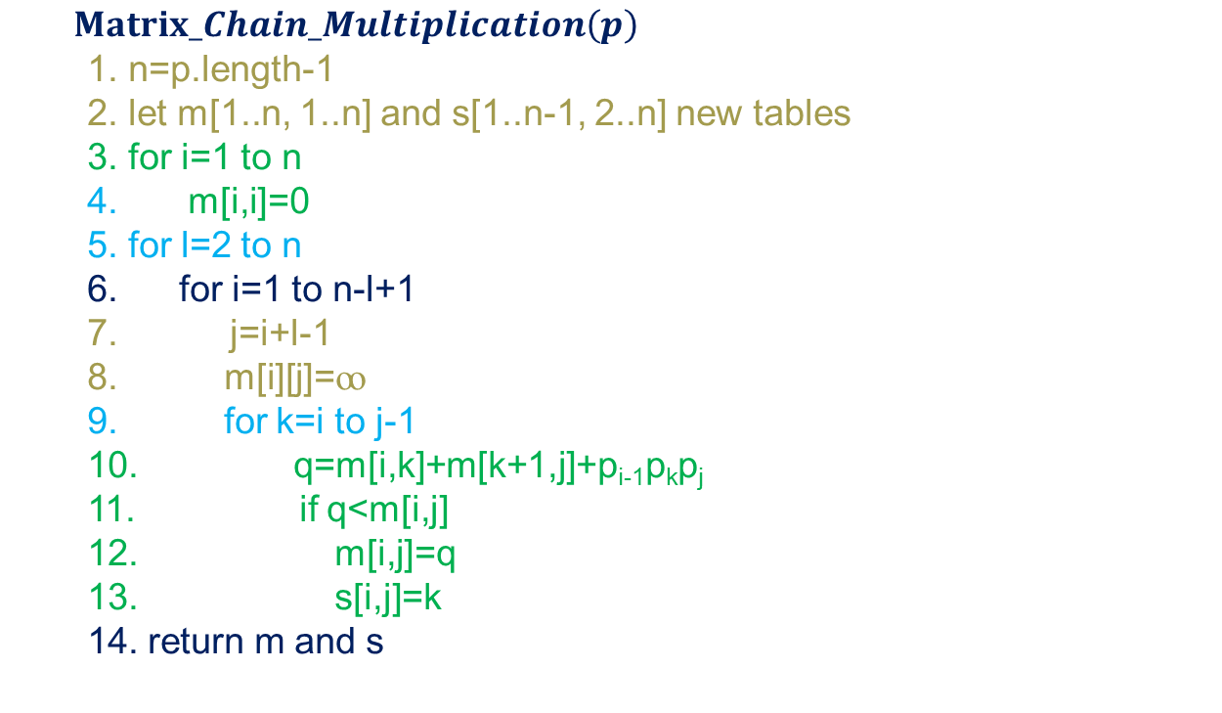
Matrix chain multiplication
$Matrix_Chain_Multiplication\left(p\right)$
1. n=p.length-1
2. let m[1..n, 1..n] and s[1..n-1, 2..n] new tables
3. for i=1 to n
4. m[i,i]=0
5. for l=2 to n
6. for i=1 to n-l+1
7. j=i+l-1
m[i][j]=ꝏ
for k=i to j-1
10. q=m[i,k]+m[k+1,j]+p_{i-1}p_{k}p_{j}
11. if q<m[i,j]
12. m[i,j]=q
13. s[i,j]=k
14. return m and s
A1
A2
A3
A4
[5x4]
[4x6]
[6x2]
[2x7]

Slide 21
Matrix chain multiplication
$Matrix_Chain_Multiplication\left(p\right)$
1. n=p.length-1
2. let m[1..n, 1..n] and s[1..n-1, 2..n] new tables
3. for i=1 to n
4. m[i,i]=0
5. for l=2 to n
6. for i=1 to n-l+1
7. j=i+l-1
m[i][j]=ꝏ
for k=i to j-1
10. q=m[i,k]+m[k+1,j]+p_{i-1}p_{k}p_{j}
11. if q<m[i,j]
12. m[i,j]=q
13. s[i,j]=k
14. return m and s
A1
A2
A3
A4
[5x4]
[4x6]
[6x2]
[2x7]
p₀

Slide 22
Matrix chain multiplication
$Matrix_Chain_Multiplication\left(p\right)$
1. n=p.length-1
2. let m[1..n, 1..n] and s[1..n-1, 2..n] new tables
3. for i=1 to n
4. m[i,i]=0
5. for l=2 to n
6. for i=1 to n-l+1
7. j=i+l-1
m[i][j]=ꝏ
for k=i to j-1
10. q=m[i,k]+m[k+1,j]+p_{i-1}p_{k}p_{j}
11. if q<m[i,j]
12. m[i,j]=q
13. s[i,j]=k
14. return m and s
A1
A2
A3
A4
[5x4]
[4x6]
[6x2]
[2x7]
p₀
p₁

Slide 23
Matrix chain multiplication
$Matrix_Chain_Multiplication\left(p\right)$
1. n=p.length-1
2. let m[1..n, 1..n] and s[1..n-1, 2..n] new tables
3. for i=1 to n
4. m[i,i]=0
5. for l=2 to n
6. for i=1 to n-l+1
7. j=i+l-1
m[i][j]=ꝏ
for k=i to j-1
10. q=m[i,k]+m[k+1,j]+p_{i-1}p_{k}p_{j}
11. if q<m[i,j]
12. m[i,j]=q
13. s[i,j]=k
14. return m and s
A1
A2
A3
A4
[5x4]
[4x6]
[6x2]
[2x7]
p₀
p₁
p₂

Slide 24
Matrix chain multiplication
$Matrix_Chain_Multiplication\left(p\right)$
1. n=p.length-1
2. let m[1..n, 1..n] and s[1..n-1, 2..n] new tables
3. for i=1 to n
4. m[i,i]=0
5. for l=2 to n
6. for i=1 to n-l+1
7. j=i+l-1
m[i][j]=ꝏ
for k=i to j-1
10. q=m[i,k]+m[k+1,j]+p_{i-1}p_{k}p_{j}
11. if q<m[i,j]
12. m[i,j]=q
13. s[i,j]=k
14. return m and s
A1
A2
A3
A4
[5x4]
[4x6]
[6x2]
[2x7]
p₀
p₁
p₂
p₃

Slide 25
Matrix chain multiplication
$Matrix_Chain_Multiplication\left(p\right)$
1. n=p.length-1
2. let m[1..n, 1..n] and s[1..n-1, 2..n] new tables
3. for i=1 to n
4. m[i,i]=0
5. for l=2 to n
6. for i=1 to n-l+1
7. j=i+l-1
m[i][j]=ꝏ
for k=i to j-1
10. q=m[i,k]+m[k+1,j]+p_{i-1}p_{k}p_{j}
11. if q<m[i,j]
12. m[i,j]=q
13. s[i,j]=k
14. return m and s
A1
A2
A3
A4
[5x4]
[4x6]
[6x2]
[2x7]
p₀
p₁
p₂
p₃
p₄

Slide 26
Matrix chain multiplication
$Matrix_Chain_Multiplication\left(p\right)$
1. n=p.length-1
2. let m[1..n, 1..n] and s[1..n-1, 2..n] new tables
3. for i=1 to n
4. m[i,i]=0
5. for l=2 to n
6. for i=1 to n-l+1
7. j=i+l-1
m[i][j]=ꝏ
for k=i to j-1
10. q=m[i,k]+m[k+1,j]+p_{i-1}p_{k}p_{j}
11. if q<m[i,j]
12. m[i,j]=q
13. s[i,j]=k
14. return m and s
4
A1
A2
A3
A4
[5x4]
[4x6]
[6x2]
[2x7]
p₀
p₁
p₂
p₃
p₄

Slide 27
Matrix chain multiplication
$Matrix_Chain_Multiplication\left(p\right)$
1. n=p.length-1
2. let m[1..n, 1..n] and s[1..n-1, 2..n] new tables
3. for i=1 to n
4. m[i,i]=0
5. for l=2 to n
6. for i=1 to n-l+1
7. j=i+l-1
m[i][j]=ꝏ
for k=i to j-1
10. q=m[i,k]+m[k+1,j]+p_{i-1}p_{k}p_{j}
11. if q<m[i,j]
12. m[i,j]=q
13. s[i,j]=k
14. return m and s
4
A1
A2
A3
A4
[5x4]
[4x6]
[6x2]
[2x7]
p₀
p₁
p₂
p₃
p₄
m
s

Slide 28
Matrix chain multiplication
$Matrix_Chain_Multiplication\left(p\right)$
1. n=p.length-1
2. let m[1..n, 1..n] and s[1..n-1, 2..n] new tables
3. for i=1 to n
4. m[i,i]=0
5. for l=2 to n
6. for i=1 to n-l+1
7. j=i+l-1
m[i][j]=ꝏ
for k=i to j-1
10. q=m[i,k]+m[k+1,j]+p_{i-1}p_{k}p_{j}
11. if q<m[i,j]
12. m[i,j]=q
13. s[i,j]=k
14. return m and s
4
A1
A2
A3
A4
[5x4]
[4x6]
[6x2]
[2x7]
p₀
p₁
p₂
p₃
p₄
m
s

Slide 29
Matrix chain multiplication
$Matrix_Chain_Multiplication\left(p\right)$
1. n=p.length-1
2. let m[1..n, 1..n] and s[1..n-1, 2..n] new tables
3. for i=1 to n
4. m[i,i]=0
5. for l=2 to n
6. for i=1 to n-l+1
7. j=i+l-1
m[i][j]=ꝏ
for k=i to j-1
10. q=m[i,k]+m[k+1,j]+p_{i-1}p_{k}p_{j}
11. if q<m[i,j]
12. m[i,j]=q
13. s[i,j]=k
14. return m and s
4
A1
A2
A3
A4
[5x4]
[4x6]
[6x2]
[2x7]
p₀
p₁
p₂
p₃
p₄
m
1 2 3 4
2 3 4
1
2
3
4
s
0
 | 0
 |  | 0
 |  |  | 0
1
2
3

Slide 30
Matrix chain multiplication
$Matrix_Chain_Multiplication\left(p\right)$
1. n=p.length-1
2. let m[1..n, 1..n] and s[1..n-1, 2..n] new tables
3. for i=1 to n
4. m[i,i]=0
5. for l=2 to n
6. for i=1 to n-l+1
7. j=i+l-1
m[i][j]=ꝏ
for k=i to j-1
10. q=m[i,k]+m[k+1,j]+p_{i-1}p_{k}p_{j}
11. if q<m[i,j]
12. m[i,j]=q
13. s[i,j]=k
14. return m and s
4
A1
A2
A3
A4
[5x4]
[4x6]
[6x2]
[2x7]
p₀
p₁
p₂
p₃
p₄
m
1 2 3 4
2 3 4
s
1
2
3
4
0
 | 0
 |  | 0
 |  |  | 0
1
2
3

Slide 31
Matrix chain multiplication
$Matrix_Chain_Multiplication\left(p\right)$
1. n=p.length-1
2. let m[1..n, 1..n] and s[1..n-1, 2..n] new tables
3. for i=1 to n
4. m[i,i]=0
5. for l=2 to n
6. for i=1 to n-l+1
7. j=i+l-1
m[i][j]=ꝏ
for k=i to j-1
10. q=m[i,k]+m[k+1,j]+p_{i-1}p_{k}p_{j}
11. if q<m[i,j]
12. m[i,j]=q
13. s[i,j]=k
14. return m and s
4
A1
A2
A3
A4
[5x4]
[4x6]
[6x2]
[2x7]
p₀
p₁
p₂
p₃
p₄
m
1 2 3 4
2 3 4
s
1
2
3
4
0
 | 0
 |  | 0
 |  |  | 0
1
2
3

Slide 32
Matrix chain multiplication
$Matrix_Chain_Multiplication\left(p\right)$
1. n=p.length-1
2. let m[1..n, 1..n] and s[1..n-1, 2..n] new tables
3. for i=1 to n
4. m[i,i]=0
5. for l=2 to n
6. for i=1 to n-l+1
7. j=i+l-1
m[i][j]=ꝏ
for k=i to j-1
10. q=m[i,k]+m[k+1,j]+p_{i-1}p_{k}p_{j}
11. if q<m[i,j]
12. m[i,j]=q
13. s[i,j]=k
14. return m and s
4
A1
A2
A3
A4
[5x4]
[4x6]
[6x2]
[2x7]
p₀
p₁
p₂
p₃
p₄
m
1 2 3 4
2 3 4
s
1
2
3
4
0
 | 0
 |  | 0
 |  |  | 0
1
2
3

Slide 33
Matrix chain multiplication
$Matrix_Chain_Multiplication\left(p\right)$
1. n=p.length-1
2. let m[1..n, 1..n] and s[1..n-1, 2..n] new tables
3. for i=1 to n
4. m[i,i]=0
5. for l=2 to n
6. for i=1 to n-l+1
7. j=i+l-1
m[i][j]=ꝏ
for k=i to j-1
10. q=m[i,k]+m[k+1,j]+p_{i-1}p_{k}p_{j}
11. if q<m[i,j]
12. m[i,j]=q
13. s[i,j]=k
14. return m and s
4
A1
A2
A3
A4
[5x4]
[4x6]
[6x2]
[2x7]
p₀
p₁
p₂
p₃
p₄
m
1 2 3 4
2 3 4
s
1
2
3
4
0
 | 0
 |  | 0
 |  |  | 0
1
2
3

Slide 34
Matrix chain multiplication
$Matrix_Chain_Multiplication\left(p\right)$
1. n=p.length-1
2. let m[1..n, 1..n] and s[1..n-1, 2..n] new tables
3. for i=1 to n
4. m[i,i]=0
5. for l=2 to n
6. for i=1 to n-l+1
7. j=i+l-1
m[i][j]=ꝏ
for k=i to j-1
10. q=m[i,k]+m[k+1,j]+p_{i-1}p_{k}p_{j}
11. if q<m[i,j]
12. m[i,j]=q
13. s[i,j]=k
14. return m and s
4
A1
A2
A3
A4
[5x4]
[4x6]
[6x2]
[2x7]
p₀
p₁
p₂
p₃
p₄
m
1 2 3 4
2 3 4
s
1
2
3
4
0
 | 0
 |  | 0
 |  |  | 0
1
2
3

Slide 35
Matrix chain multiplication
$Matrix_Chain_Multiplication\left(p\right)$
1. n=p.length-1
2. let m[1..n, 1..n] and s[1..n-1, 2..n] new tables
3. for i=1 to n
4. m[i,i]=0
5. for l=2 to n
6. for i=1 to n-l+1
7. j=i+l-1
m[i][j]=ꝏ
for k=i to j-1
10. q=m[i,k]+m[k+1,j]+p_{i-1}p_{k}p_{j}
11. if q<m[i,j]
12. m[i,j]=q
13. s[i,j]=k
14. return m and s
4
A1
A2
A3
A4
[5x4]
[4x6]
[6x2]
[2x7]
p₀
p₁
p₂
p₃
p₄
m
1 2 3 4
2 3 4
s
1
2
3
4
0
 | 0
 |  | 0
 |  |  | 0
1
2
3

Slide 36
Matrix chain multiplication
$Matrix_Chain_Multiplication\left(p\right)$
1. n=p.length-1
2. let m[1..n, 1..n] and s[1..n-1, 2..n] new tables
3. for i=1 to n
4. m[i,i]=0
5. for l=2 to n
6. for i=1 to n-l+1
7. j=i+l-1
m[i][j]=ꝏ
for k=i to j-1
10. q=m[i,k]+m[k+1,j]+p_{i-1}p_{k}p_{j}
11. if q<m[i,j]
12. m[i,j]=q
13. s[i,j]=k
14. return m and s
4
A1
A2
A3
A4
[5x4]
[4x6]
[6x2]
[2x7]
p₀
p₁
p₂
p₃
p₄
m
1 2 3 4
2 3 4
s
1
2
3
4
0
 | 0
 |  | 0
 |  |  | 0
1
2
3
q=m[1,2]=m[1,1]+m[2,2]+p₀p₁p₂
= 0+0+5x4x6=120 k=1

Slide 37
Matrix chain multiplication
$Matrix_Chain_Multiplication\left(p\right)$
1. n=p.length-1
2. let m[1..n, 1..n] and s[1..n-1, 2..n] new tables
3. for i=1 to n
4. m[i,i]=0
5. for l=2 to n
6. for i=1 to n-l+1
7. j=i+l-1
m[i][j]=ꝏ
for k=i to j-1
10. q=m[i,k]+m[k+1,j]+p_{i-1}p_{k}p_{j}
11. if q<m[i,j]
12. m[i,j]=q
13. s[i,j]=k
14. return m and s
4
A1
A2
A3
A4
[5x4]
[4x6]
[6x2]
[2x7]
p₀
p₁
p₂
p₃
p₄
m
1 2 3 4
2 3 4
s
1
2
3
4
0 | 120
 | 0
 |  | 0
 |  |  | 0
1
2
3
1
q=m[1,2]=m[1,1]+m[2,2]+p₀p₁p₂
= 0+0+5x4x6=120 k=1

Slide 38
Matrix chain multiplication
$Matrix_Chain_Multiplication\left(p\right)$
1. n=p.length-1
2. let m[1..n, 1..n] and s[1..n-1, 2..n] new tables
3. for i=1 to n
4. m[i,i]=0
5. for l=2 to n
6. for i=1 to n-l+1
7. j=i+l-1
m[i][j]=ꝏ
for k=i to j-1
10. q=m[i,k]+m[k+1,j]+p_{i-1}p_{k}p_{j}
11. if q<m[i,j]
12. m[i,j]=q
13. s[i,j]=k
14. return m and s
4
A1
A2
A3
A4
[5x4]
[4x6]
[6x2]
[2x7]
p₀
p₁
p₂
p₃
p₄
m
1 2 3 4
2 3 4
s
1
2
3
4
0 | 120
 | 0 | 48
 |  | 0
 |  |  | 0
1
2
3
1
 | 2
q=m[2,3]=m[1,2]+m[3,3]+p₁p₂p₃
= 0+0+4x6x2=48 k=2
s[2,3]=2

Slide 39
Matrix chain multiplication
$Matrix_Chain_Multiplication\left(p\right)$
1. n=p.length-1
2. let m[1..n, 1..n] and s[1..n-1, 2..n] new tables
3. for i=1 to n
4. m[i,i]=0
5. for l=2 to n
6. for i=1 to n-l+1
7. j=i+l-1
m[i][j]=ꝏ
for k=i to j-1
10. q=m[i,k]+m[k+1,j]+p_{i-1}p_{k}p_{j}
11. if q<m[i,j]
12. m[i,j]=q
13. s[i,j]=k
14. return m and s
4
A1
A2
A3
A4
[5x4]
[4x6]
[6x2]
[2x7]
p₀
p₁
p₂
p₃
p₄
m
1 2 3 4
2 3 4
s
1
2
3
4
0 | 120
 | 0 | 48
 |  | 0
 |  |  | 0
1
2
3
1
 | 2
q=m[3,4]=m[3,3]+m[4,4]+p₂p₃p₄
= 0+0+6x2x7=84 k=3
s[3,4]=3

Slide 40
Matrix chain multiplication
$Matrix_Chain_Multiplication\left(p\right)$
1. n=p.length-1
2. let m[1..n, 1..n] and s[1..n-1, 2..n] new tables
3. for i=1 to n
4. m[i,i]=0
5. for l=2 to n
6. for i=1 to n-l+1
7. j=i+l-1
m[i][j]=ꝏ
for k=i to j-1
10. q=m[i,k]+m[k+1,j]+p_{i-1}p_{k}p_{j}
11. if q<m[i,j]
12. m[i,j]=q
13. s[i,j]=k
14. return m and s
4
A1
A2
A3
A4
[5x4]
[4x6]
[6x2]
[2x7]
p₀
p₁
p₂
p₃
p₄
m
1 2 3 4
2 3 4
s
1
2
3
4
0 | 120
 | 0 | 48
 |  | 0 | 84
 |  |  | 0
1
2
3
1
 | 2
 |  | 3
q=m[3,4]=m[3,3]+m[4,4]+p₂p₃p₄
= 0+0+6x2x7=84 k=3
s[3,4]=3

Slide 41
Matrix chain multiplication
$Matrix_Chain_Multiplication\left(p\right)$
1. n=p.length-1
2. let m[1..n, 1..n] and s[1..n-1, 2..n] new tables
3. for i=1 to n
4. m[i,i]=0
5. for l=2 to n
6. for i=1 to n-l+1
7. j=i+l-1
m[i][j]=ꝏ
for k=i to j-1
10. q=m[i,k]+m[k+1,j]+p_{i-1}p_{k}p_{j}
11. if q<m[i,j]
12. m[i,j]=q
13. s[i,j]=k
14. return m and s
4
A1
A2
A3
A4
[5x4]
[4x6]
[6x2]
[2x7]
p₀
p₁
p₂
p₃
p₄
m
1 2 3 4
2 3 4
s
1
2
3
4
0 | 120
 | 0 | 48
 |  | 0 | 84
 |  |  | 0
1
2
3
1
 | 2
 |  | 3
q=m[1,3]=m[1,1]+m[2,3]+p₀p₁p₃
= 0+48+5x4x2=88 k=1
or
q=m[1,3]=m[1,2]+m[3,3]+p₀p₂p₃
= 120+0+5x6x2=180

Slide 42
Matrix chain multiplication
$Matrix_Chain_Multiplication\left(p\right)$
1. n=p.length-1
2. let m[1..n, 1..n] and s[1..n-1, 2..n] new tables
3. for i=1 to n
4. m[i,i]=0
5. for l=2 to n
6. for i=1 to n-l+1
7. j=i+l-1
m[i][j]=ꝏ
for k=i to j-1
10. q=m[i,k]+m[k+1,j]+p_{i-1}p_{k}p_{j}
11. if q<m[i,j]
12. m[i,j]=q
13. s[i,j]=k
14. return m and s
4
A1
A2
A3
A4
[5x4]
[4x6]
[6x2]
[2x7]
p₀
p₁
p₂
p₃
p₄
m
1 2 3 4
2 3 4
s
1
2
3
4
0 | 120
 | 0 | 48
 |  | 0 | 84
 |  |  | 0
1
2
3
1
 | 2
 |  | 3
q=m[1,3]=m[1,1]+m[2,3]+p₀p₁p₃
= 0+48+5x4x2=88 k=1
or
q=m[1,3]=m[1,2]+m[3,3]+p₀p₂p₃
= 120+0+5x6x2=180 k=2

Slide 43
Matrix chain multiplication
$Matrix_Chain_Multiplication\left(p\right)$
1. n=p.length-1
2. let m[1..n, 1..n] and s[1..n-1, 2..n] new tables
3. for i=1 to n
4. m[i,i]=0
5. for l=2 to n
6. for i=1 to n-l+1
7. j=i+l-1
m[i][j]=ꝏ
for k=i to j-1
10. q=m[i,k]+m[k+1,j]+p_{i-1}p_{k}p_{j}
11. if q<m[i,j]
12. m[i,j]=q
13. s[i,j]=k
14. return m and s
4
A1
A2
A3
A4
[5x4]
[4x6]
[6x2]
[2x7]
p₀
p₁
p₂
p₃
p₄
m
1 2 3 4
2 3 4
s
1
2
3
4
0 | 120
 | 0 | 48
 |  | 0 | 84
 |  |  | 0
1
2
3
1
 | 2
 |  | 3

Slide 44
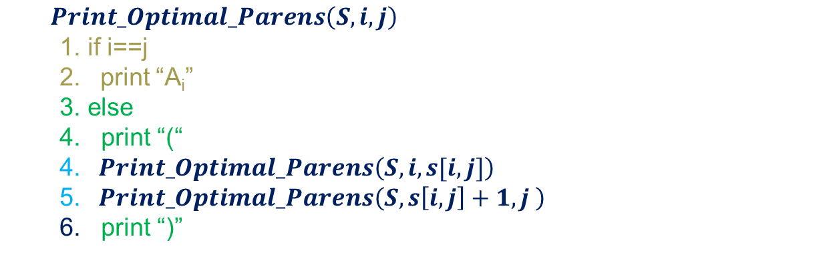
Matrix chain multiplication
$Print_Optimal_Parens\left(S,i,j\right)$
1. if i==j
2. print “A_{i}”
3. else
4. print “(“
4. $Print_Optimal_Parens\left(S,i,s[i,j]\right)$
5. $Print_Optimal_Parens\left(S,s\left[i,j\right]+1,j \right)$
6. print “)”
A1
A2
A3
A4
[5x4]
[4x6]
[6x2]
[2x7]
p₀
p₁
p₂
p₃
p₄
m
1 2 3 4
2 3 4
s
1
2
3
4
0 | 120
 | 0 | 48
 |  | 0 | 84
 |  |  | 0
1
2
3
1
 | 2
 |  | 3

Slide 45
Thank You

Slide 46
All Pair Shortest Paths
Design and Analysis of
Algorithms
Rajesh Kumar Tripathi
Assistant Professor, Dept. CEA

Slide 47
All pair shortest paths
Find shortest paths between all pairs of vertices in a graph.
This problem might arise in making a table of distances between all pairs of cities for a road atlas.

Slide 48
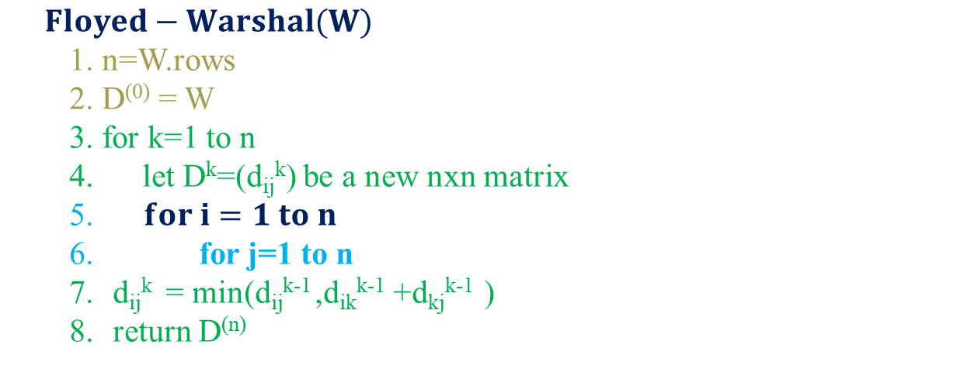
Floyd-Warshal Algorithm
$Floyed−Warshal(W)$
1. n=W.rows
2. D⁽⁰⁾ = W
3. for k=1 to n
4. let D^{k}=(d_{ij}^{k}) be a new nxn matrix
5. $for i=1 to n$
6. for j=1 to n
d_{ij}^{k} = min(d_{ij}^{k-1} ,d_{ik}^{k-1} +d_{kj}^{k-1} )
return D^{(n)}

Slide 49
Floyd-Warshal Algorithm
$Floyed−Warshal(W)$
1. n=W.rows
2. D⁽⁰⁾ = W
3. for k=1 to n
4. let D^{k}=(d_{ij}^{k}) be a new nxn matrix
5. $for i=1 to n$
6. for j=1 to n
d_{ij}^{k} = min(d_{ij}^{k-1} ,d_{ik}^{k-1} +d_{kj}^{k-1} )
return D^{(n)}

Slide 50
Floyd-Warshal Algorithm
$Floyed−Warshal(W)$
1. n=W.rows
2. D⁽⁰⁾ = W
3. for k=1 to n
4. let D^{k}=(d_{ij}^{k}) be a new nxn matrix
5. $for i=1 to n$
6. for j=1 to n
d_{ij}^{k} = min(d_{ij}^{k-1} ,d_{ik}^{k-1} +d_{kj}^{k-1} )
return D^{(n)}

Slide 51

Floyd-Warshal Algorithm
$Floyd−Warshal(W)$
1. n=W.rows
2. D⁽⁰⁾ = W
3. for k=1 to n
4. let D^{k}=(d_{ij}^{k}) be a new nxn matrix
5. $for i=1 to n$
6. for j=1 to n
d_{ij}^{k} = min(d_{ij}^{k-1} ,d_{ik}^{k-1} +d_{kj}^{k-1} )
return D^{(n)}

Slide 52
Floyd-Warshal Algorithm
$Floyed−Warshal(W)$
1. n=W.rows
2. D⁽⁰⁾ = W
3. for k=1 to n
4. let D^{k}=(d_{ij}^{k}) be a new nxn matrix
5. $for i=1 to n$
6. for j=1 to n
d_{ij}^{k} = min(d_{ij}^{k-1} ,d_{ik}^{k-1} +d_{kj}^{k-1} )
return D^{(n)}

Slide 53
Floyd-Warshal Algorithm
$Floyed−Warshal(W)$
1. n=W.rows
2. D⁽⁰⁾ = W
3. for k=1 to n
4. let D^{k}=(d_{ij}^{k}) be a new nxn matrix
5. $for i=1 to n$
6. for j=1 to n
d_{ij}^{k} = min(d_{ij}^{k-1} ,d_{ik}^{k-1} +d_{kj}^{k-1} )
return D^{(n)}

Slide 54
Floyd-Warshal Algorithm
$Floyed−Warshal(W)$
1. n=W.rows
2. D⁽⁰⁾ = W
3. for k=1 to n
4. let D^{k}=(d_{ij}^{k}) be a new nxn matrix
5. $for i=1 to n$
6. for j=1 to n
d_{ij}^{k} = min(d_{ij}^{k-1} ,d_{ik}^{k-1} +d_{kj}^{k-1} )
return D^{(n)}

Slide 55
Thank You

